Slide 1

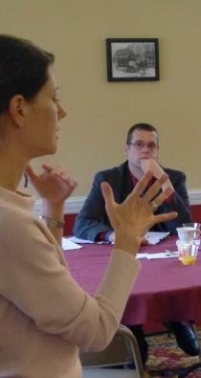
IMPACT SEE (Surrogate EHR Environment) Training
January 2015

Slide 2
Agenda
Introductions
The problem with care transitions
IMPACT Project
SEE Demo
SEE Skills Assessment Test

Slide 3
The Spectrum of Care is Vast…
High
Acute Care Hospital
PACE
Psych Hospital
Emergency Department
Home Health
LTACH
Outpt. Behav. Health
CBS
Outpt. Rehab
Adult Day Care
Intensity of Care
IRF
Urgent Care
SNF
Hospice Facility
Physician Office
Nursing Home
Outpatient Testing/Pharmacy/DME
Home Hospice
Assist Living
Living at Home
Low
Acuity of Illness
High
Adapted from Derr and Wolf, 2012

Slide 4






…as are the Barriers to Care Coordination
High
Acute Care Hospital
PACE
Psych Hospital
Emergency Department
Home Health
LTACH
Outpt. Behav. Health
CBS
Outpt. Rehab
Adult Day Care
Intensity of Care
IRF
Urgent Care
SNF
Hospice Facility
Physician Office
Nursing Home
Outpatient Testing/Pharmacy/DME
Home Hospice
Assist Living
Living at Home
Low
Acuity of Illness
High
Adapted from Derr and Wolf, 2012

Slide 5

The Problem
15% of ER admissions and $8 Billion wasted annually that could be avoided if outpatient information was known
1.5 Million preventable adverse events annually nationwide from discharge treatment plans not followed
20% of patients are readmitted within 30 days. Preventable readmissions waste $577 Million in Massachusetts and $25B nationwide annually

Slide 6
The Importance of LTPAC
Hospitalized patients are the sickest population and account for ~75% of Medicare costs
~40% of Medicare patients are discharged to traditional LTPAC settings (SNF, Home Health, Inpatient Rehab Facility, etc…)
Sources: http://aspe.hhs.gov/health/reports/2011/pacexpanded/index.shtml#ch1
http://www.medpac.gov/documents/Jun11DataBookEntireReport.pdf

Slide 7
IMPACT Grant
February 2011 – HHS/ONC awarded $1.7M HIE Challenge Grant to state of Massachusetts (MTC/MeHI):
Improving Massachusetts Post-Acute Care Transfers (IMPACT)

Slide 8
IMPACT Objectives & Strategies
Facilitate developing a national standard of data elements for transitions across the continuum of care
Develop software tools to acquire/view/edit/send these data elements (LAND & SEE)
Integrate and validate tools into Worcester County using Learning Collaborative methodology
Measure outcomes

Slide 9
Pilot Sites to Test the Datasets
Selection Criteria:
High volume of patient transfers with other pilot sites
Experience with Transitions of Care tools/initiatives
17 Winning Pilot Sites:
St Vincent Hospital and UMass Memorial Healthcare
Reliant Medical Group (formerly known as Fallon Clinic) and Family Health Center of Worcester (FQHC)
2 Home Health agencies (VNA Care Network & Overlook VNA)
1 Inpatient Rehab Facility (Fairlawn)
1 LTAC (Kindred Parkview)
1 Payer (Fallon Community Health Plan)
8 Skilled Nursing and Extended Care Facilities

Slide 10
Nursing Facility Pilot Sites
Beaumont Rehabilitation of Westborough
Christopher House of Worcester
Holy Trinity Nursing & Rehab
Jewish Healthcare Center
LifeCare Center of Auburn (+EMR)
Millbury Healthcare Center
Notre Dame LTC
Worcester Rehabilitation & Health Care Center
Notes:
Lifecare Center of Auburn – has an EMR
Jewish Healthcare and Millbury are transitioning to an EMR

Slide 11
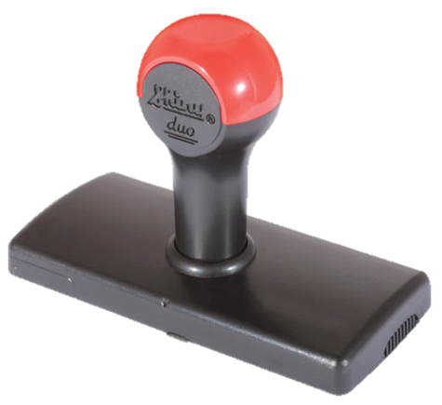
NYeC, Healthix, CCITINY, ASPE, S&I LCC, HL7, and Lantana update C-CDA for MU3 and 2017 EHR Cert
Consultation Note (update):
Office Visit to PHR
Consultant to PCP
ED to PCP, SNF, etc…
Home Health Plan of Care
(with esMD Digital Signature)
Care Plan
5 – Transfer of Care Summary
HL7 C-CDA R2.0
Published 12/14
HH POC (CMS-485)
Care Plan
3 – Shared Care Encounter Summary
4 – Consultation Request Clinical Summary
Referral Note:
PCP to Consultant
PCP, SNF, etc… to ED
Transfer Summary:
Hospital to SNF, PCP, HHA, etc…
SNF, PCP, etc… to HHA
PCP to new PCP
11
Notes:
Including coordinating with esMD/CMS engagement
Ballot through Structured Documents Workgroup
>$500K of public and private funding

Slide 12


Getting Connected: LAND & SEE, KeyHIE Transform, and

Slide 13
LAND & SEE
Sites with EHR or electronic assessment tool use these applications to enter data elements
LAND (“Local” Adaptor for Network Distribution) acts as a data courier to gather, transform, and securely transfer data if no support for Direct SMTP/SMIME or IHE XDR
Non-EHR users complete all of the data fields and routing using a web browser to access their “Surrogate EHR Environment” (SEE)
Notes:
Consider using IHE’s RFD (Retrieve Form for Data Capture) Profile to embed form to capture missing data elements.
Alternatively might use CCOW to maintain patient context between EHR and LAND
SEE:
Acts as a destination for routed CCD+ documents
Software hosted by a trusted authority and accessed via a web browser
Non-EHR users will be able to use SEE to view, edit, and send CCD+ documents via HIE or Direct to next facility
SEE users will also be able to locally print, securely email, or fax copies of the CCD+
Local administrator will manage that organization’s UserIDs/Passwords/Roles
Investigating integration with MDS, INTERACT, CMS-485 and OASIS. Geisinger is grabbing copies of MDS and OASIS and loading it into KeyHIE

Slide 14

MA State Public HIE
Phase 1 – Send and Receive
Building the HIway and Provider Directory
Setting up “Webmail” Mailboxes for non-EHR users
Distributing LAND to EHR users
“Pushing” patient information using Direct

Slide 15
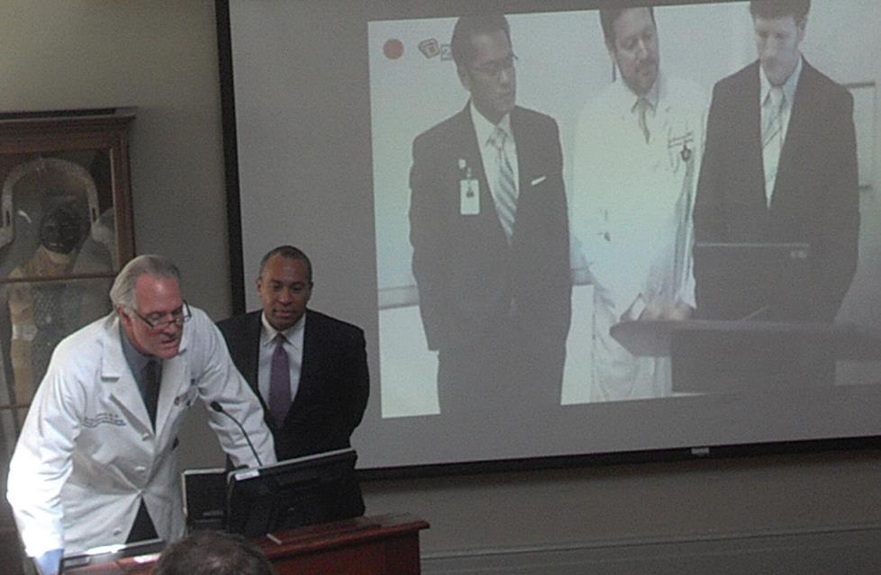
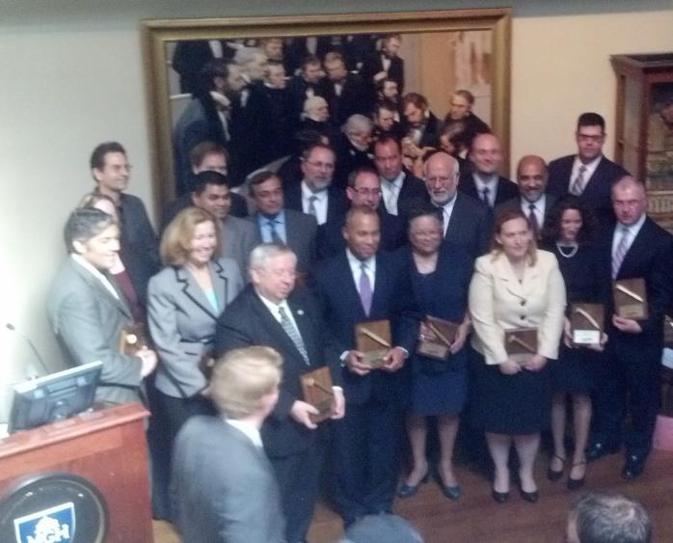
“Golden Spike” – 10/16/2012
First medical record sent: Governor Deval Patrick
Mass General Hospital to Bay State Medical Center

Slide 16
HIway Transaction Activity
13 Month HIway Transaction Activity
655,378 Transactions * exchanged during November
5,202,011 Total Transactions * (inception to date)
* Note: Includes all transactions over Mass HIway, both production and provider test

Slide 17
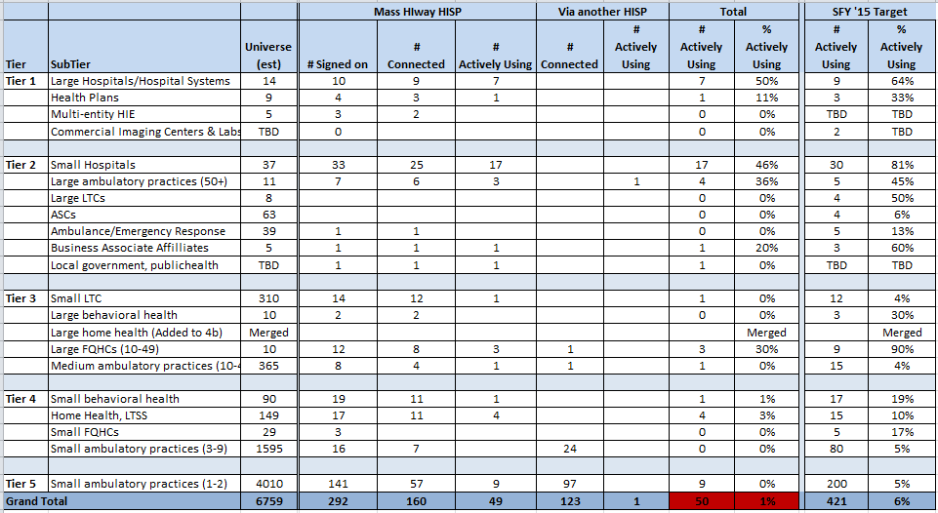
Progress Towards SFY’15 Targets
Progress Relative to SFY ’15 Targets

Slide 18

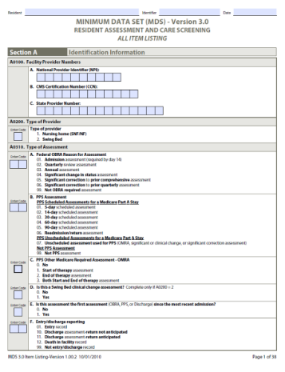
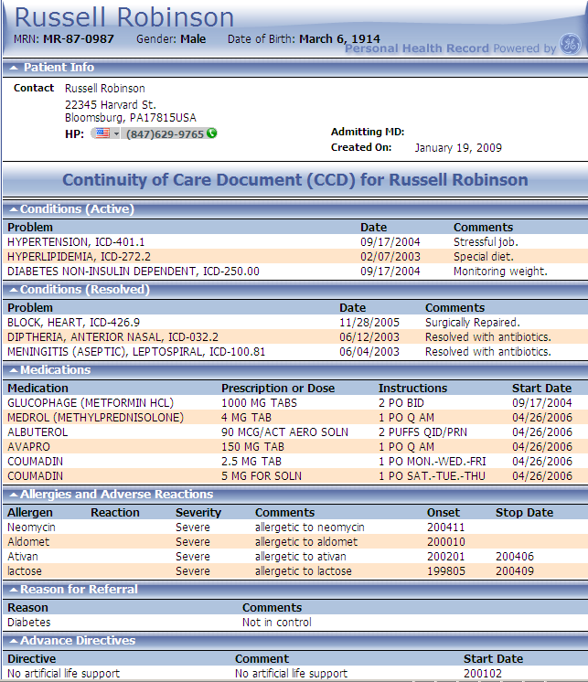

KeyHIE Transform Supplement
Developed with AHIMA, ASPE, and S&I (LCC workgroup)
HL7 Balloted. Nationally available Web service.
LTPAC
MDS or OASIS
Clinical Summary
HIE
Transform.KeyHIE.org
Copyright 2013 Keystone Beacon Community
18
18

Slide 19
KeyHIE Transform Supplement
Connects via Surescripts HISP
Has completed HISP-HISP connectivity with MA HIway
Only need contract between each facility that wants to use it and KeyHIE
Copyright 2013 Keystone Beacon Community
19
19

Slide 20
So when do we go live?

Slide 21





Monday
June 15th 2015!

Slide 22
SEE Demo/Training
Video available at:
http://mehi.masstech.org/impact-see-training

Slide 23
SEE Demo/Training
Scenarios:
View received CDA and print it
Find and Edit previously received CDA
Find previously edited CDA and Send it
Start new CDA from scratch
Create a CDA from documents received from Hospital and MDS

Slide 24


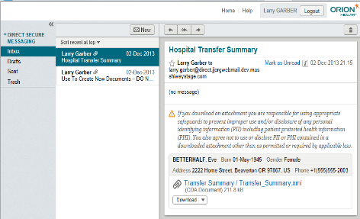



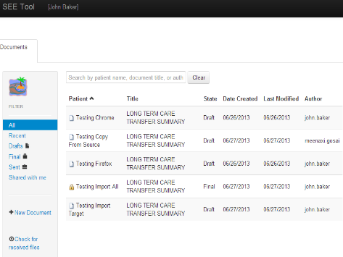
High Level Overview
Webmail Mailbox for Facility
Temporary storage for incoming
and outgoing messages/documents
Other Facilities
Other Providers
Facility staff and providers with access to a shared Webmail and SEE mailbox
SEE Document Storage for Facility
Permanent storage for:
Incoming Finalized documents,
New Draft documents
Outgoing Finalized documents

Slide 25
View Received Document

Slide 26
View Received Document
Receive Text Message that new mail has arrived
Login to organization’s Webmail mailbox
Open the new mail
Download the attached document to SEE
View and print the document from SEE
Exit SEE, returning back to Webmail
Delete the originally received message

Slide 27
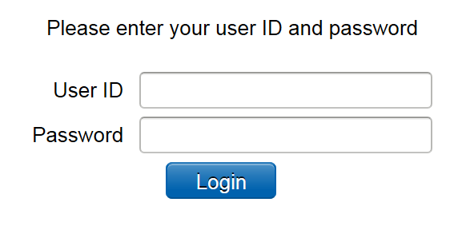
Login to Webmail

Slide 28
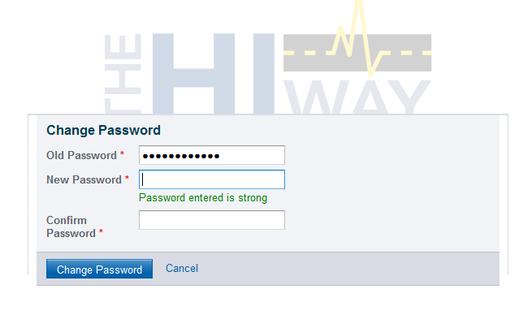
First Time: Create new password

Slide 29
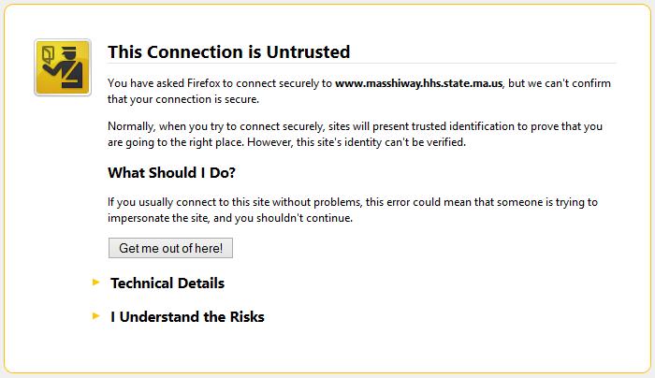
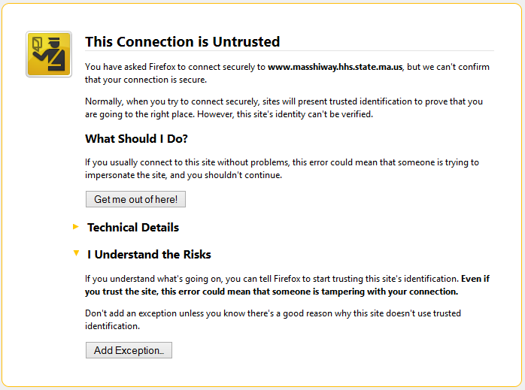
If you get a warning…
Click “I Understand the Risks” and then “Add Exception…”

Slide 30
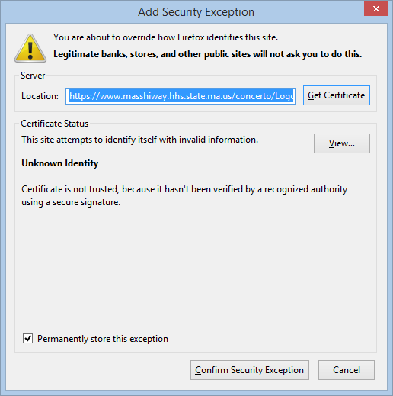
If you get a warning…
Make sure this is checked
Click “Confirm Security Exception”

Slide 31
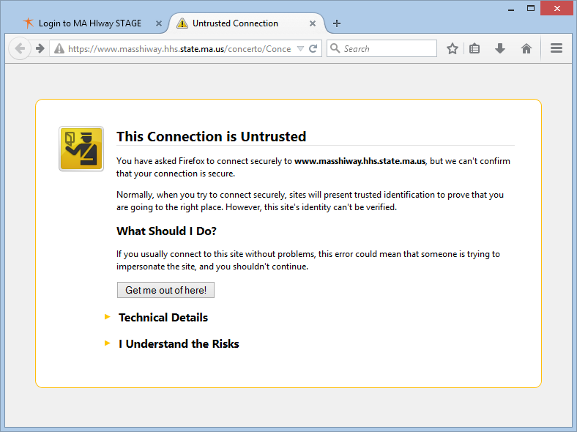
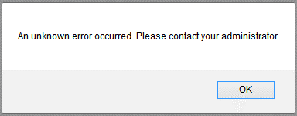
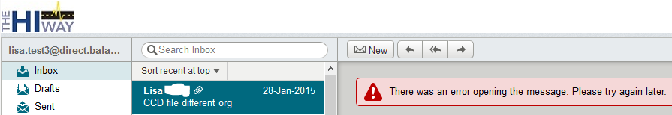
If you still get a warning…
Click “Reload Current Page” symbol

Slide 32
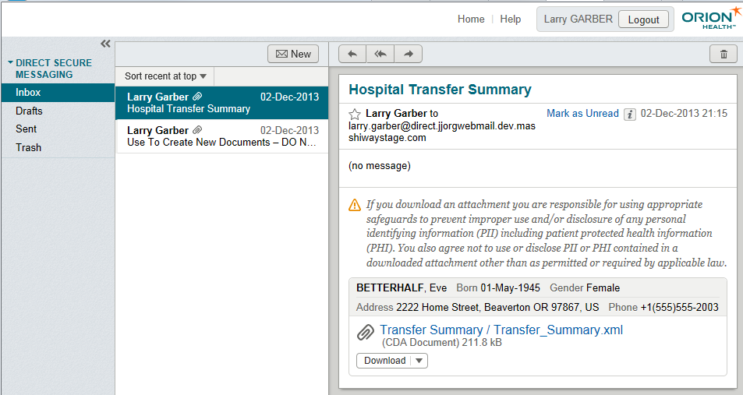
Open New Mail

Slide 33
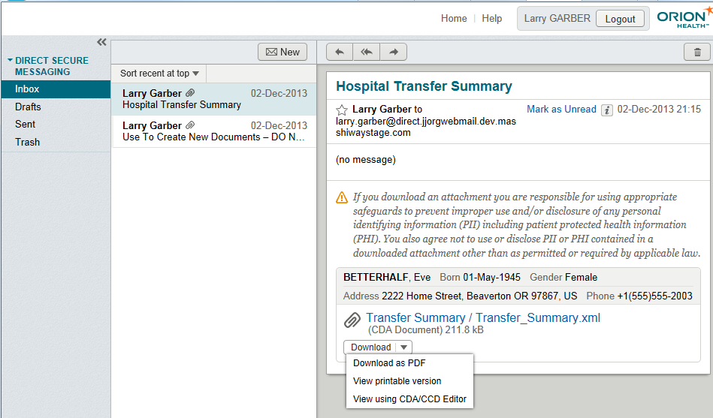
Download Attached Document

Slide 34
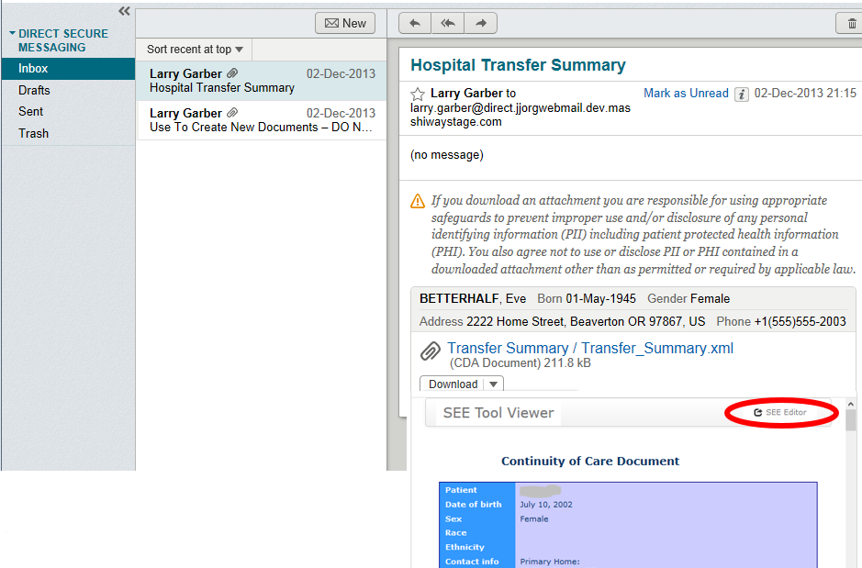
Download Attached Document

Slide 35
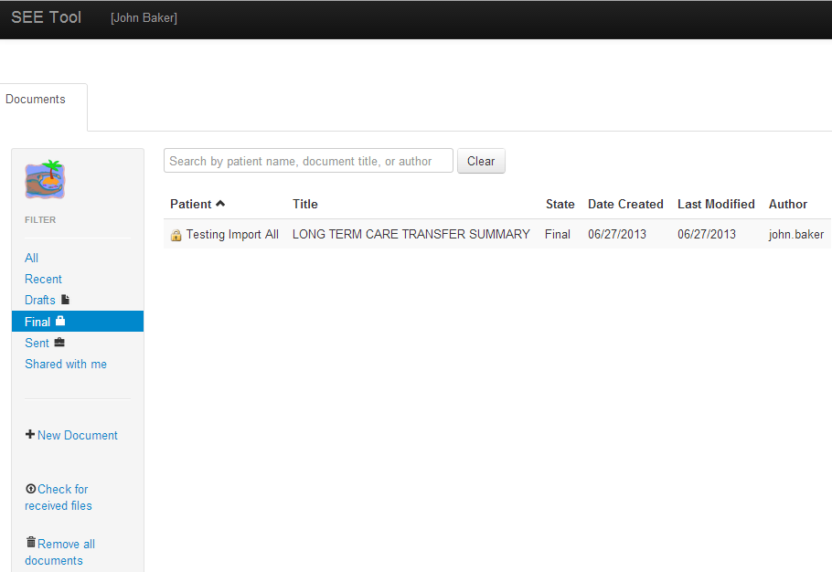
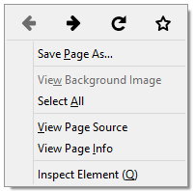
Reload if you don’t see your CCD
Right-Click on blank area and then click on Reload symbol

Slide 36
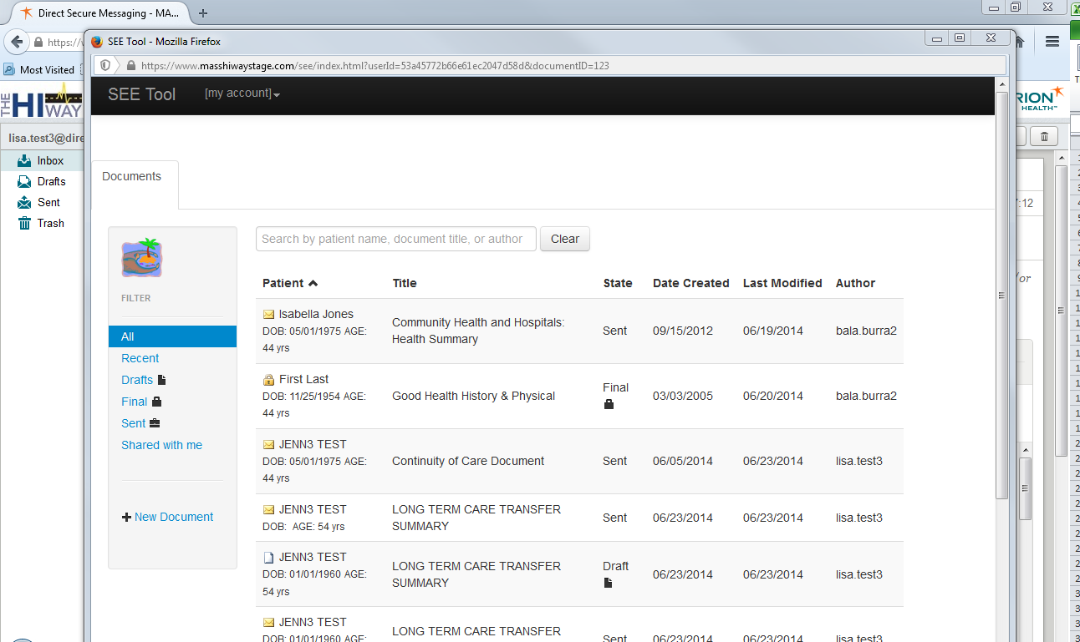
Click to Maximize Window

Slide 37
Enter Your Information
First time you access SEE, you will need to enter information about yourself
Name
Credentials
Contact Information
NPI Number (if applicable)
Makes it easier for SEE to add your information to your documents
Will never have to enter this again

Slide 38
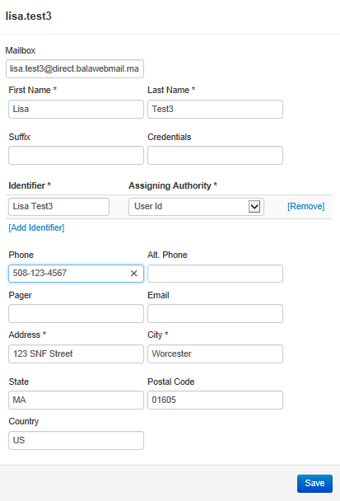
First login – fill out all user info

Slide 39
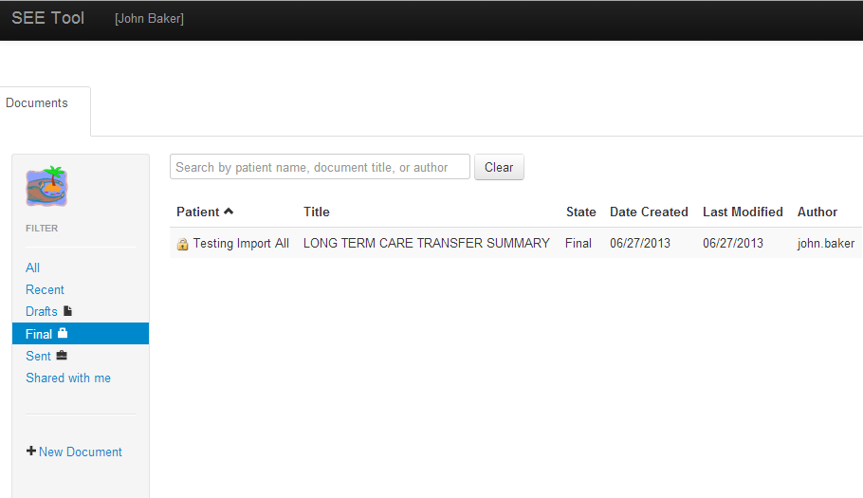
Click to update user info any time

Slide 40
Click on your document
Hint: If you have a lot of documents in the list, click on “Last Modified” to sort your document to the top of the list

Slide 41
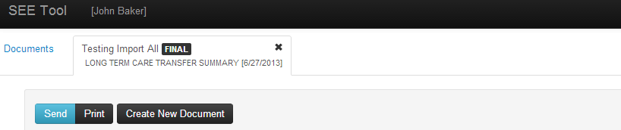
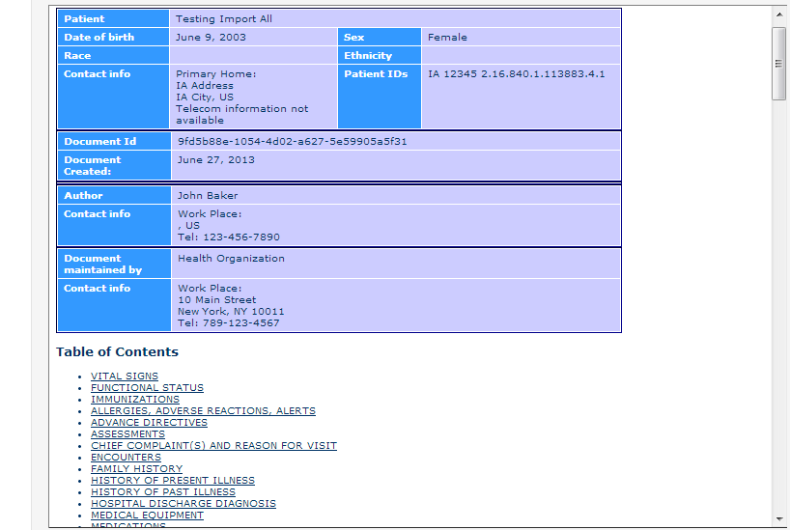
View the Document in SEE

Slide 42
Print the Document in SEE

Slide 43
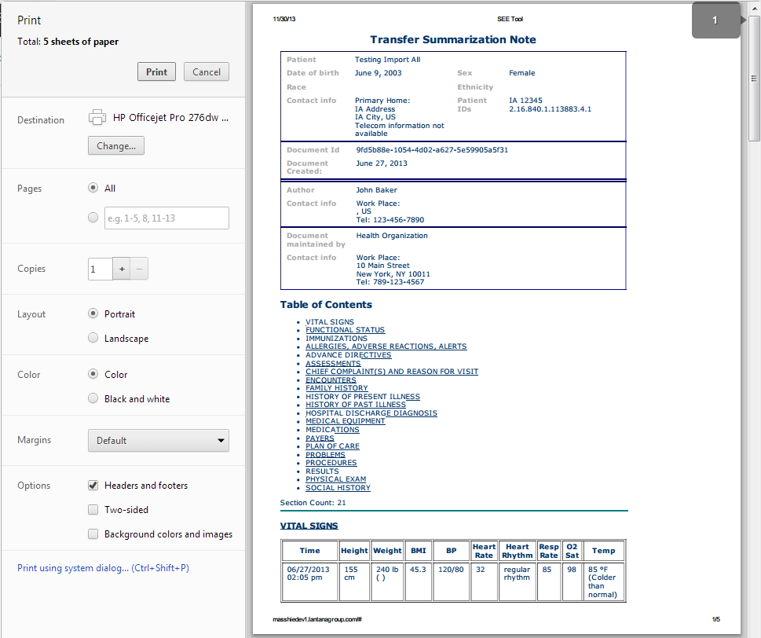
Print the Document From SEE

Slide 44
Exit SEE – Notice Tabs on Top

Slide 45

Exit SEE – Notice Left “Activities”

Slide 46
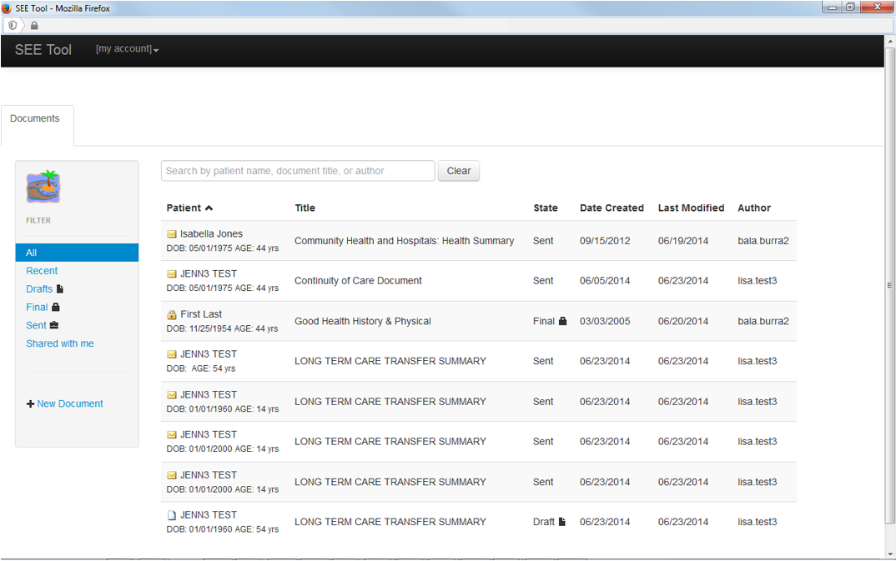
Exit SEE – Click “X”

Slide 47
Delete Original Message

Slide 48
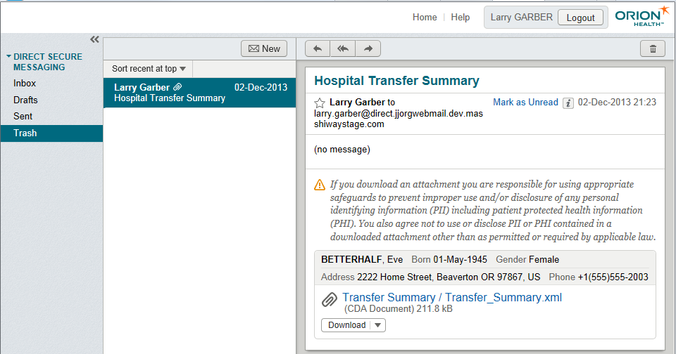
Delete Original Message

Slide 49
Find and Edit Previously Received Document

Slide 50
Find and Edit Prior Document
Login to organization’s Webmail mailbox
Open the blank “Use To Create New Documents – DO NOT DELETE!” mail
Download the attached document to SEE
Find the old document in SEE
Copy all or part of old document into new document
Edit new document
Save new document as a draft
Exit SEE, returning back to Webmail

Slide 51
Login to Webmail

Slide 52
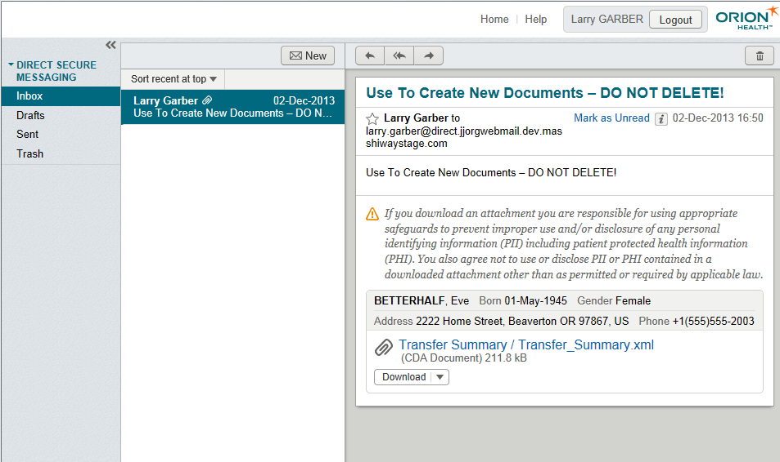
Open DO NOT DELETE Mail

Slide 53
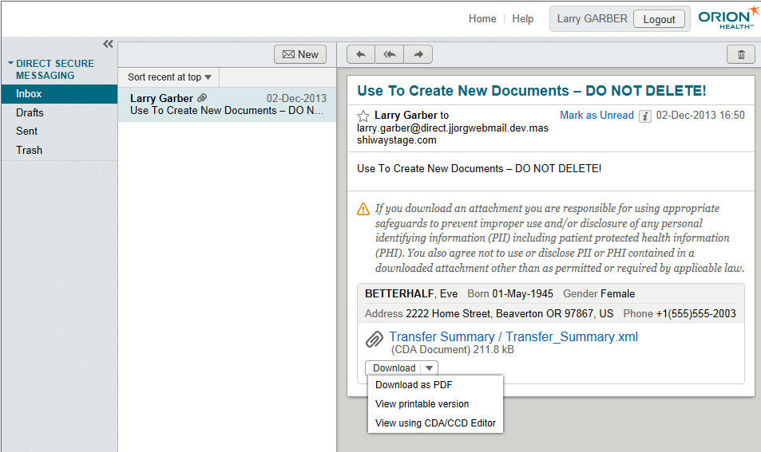
Download Attached Document

Slide 54
Download Attached Document

Slide 55
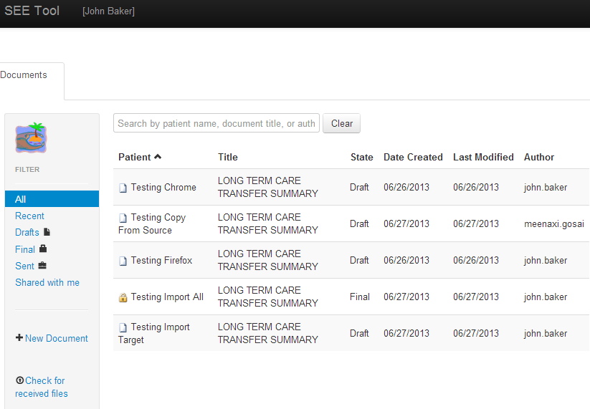
Search by Patient Name

Slide 56
Copy All Into New Document

Slide 57
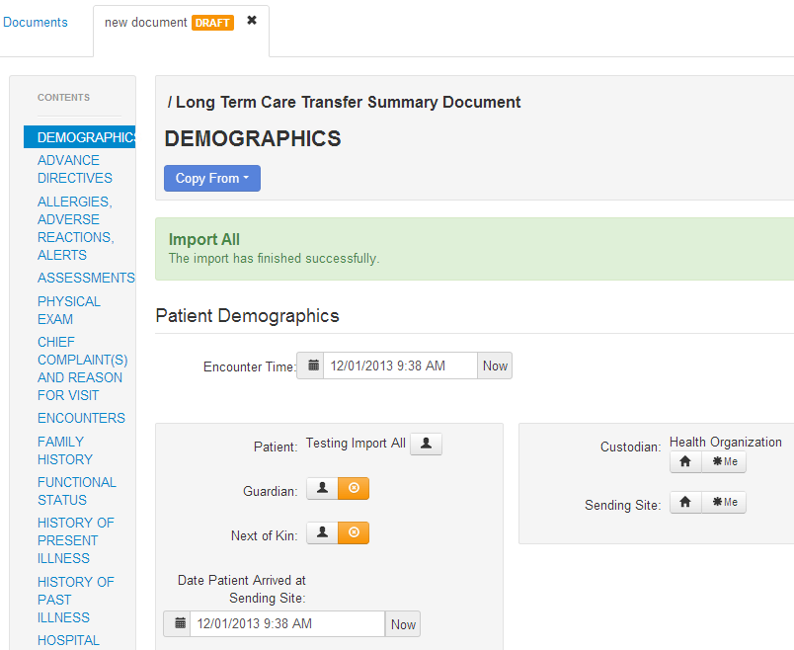
Copy All - Success!

Slide 58
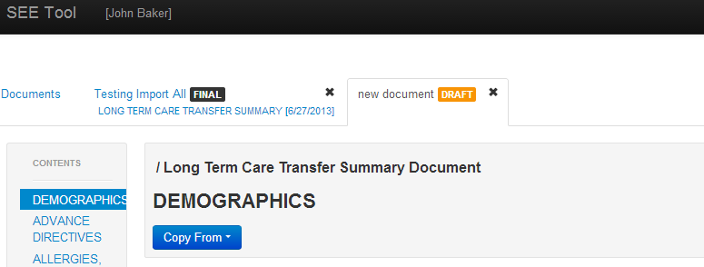
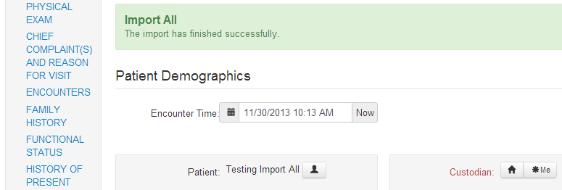
Review and Update Each Section

Slide 59
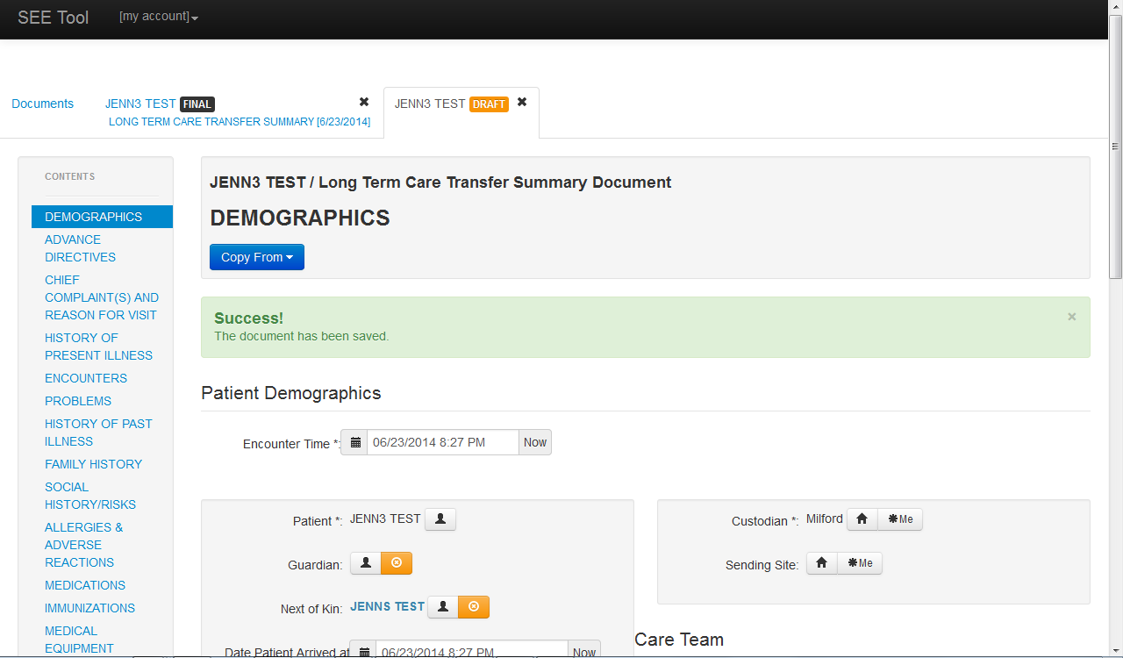
Ctrl-Minus until Save is visible

Slide 60
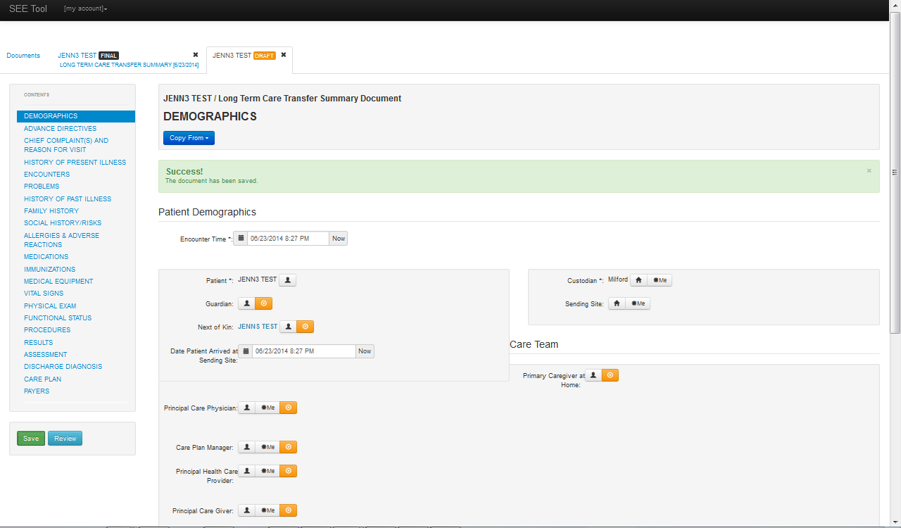
Ctrl-Minus until Save is visible

Slide 61
Ctrl-Zero returns to original size

Slide 62
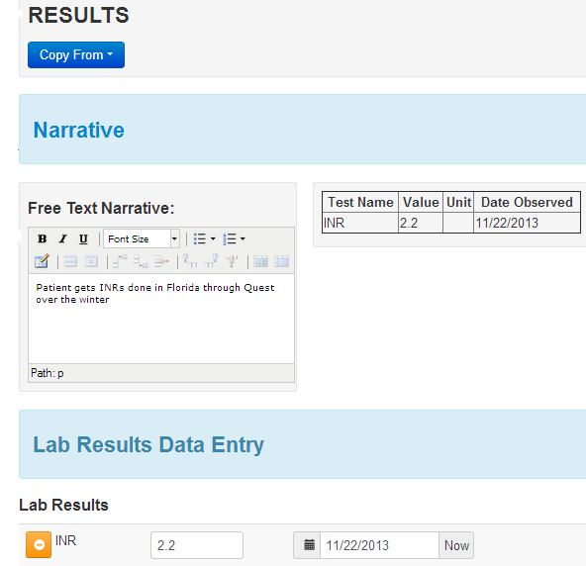
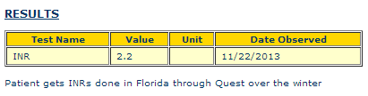
Each Section - Standard Layout
Section name
Copy section from another document
Free text
Free text and Specific data are merged into the final document’s section display
Specific data entered below displays above

Slide 63
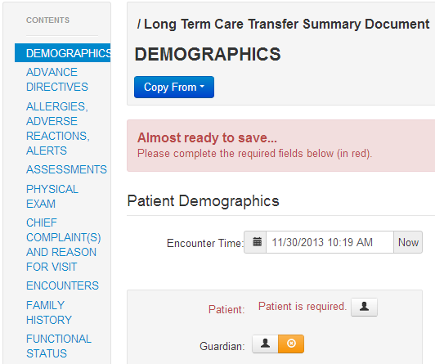
Notice Red Required Fields

Slide 64
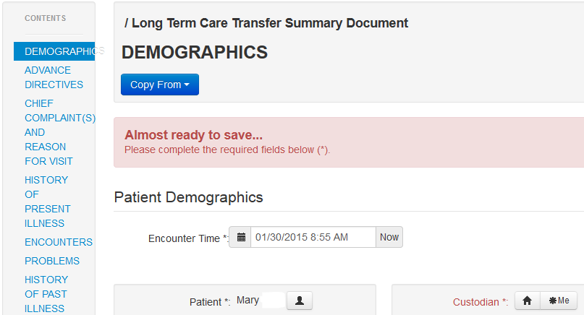
Notice Red Required Fields
Note: You can’t move to another section until you enter the missing information

Slide 65
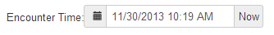
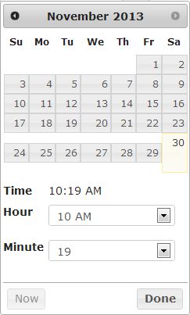
Notice Standard Fields
Pop-up a
standard
calendar
Enter current
date & time

Slide 66
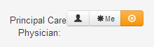
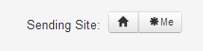
Notice Standard Fields
Delete Entry
Person
If User is
that Person
Organization
If User is
from that
Organization

Slide 67
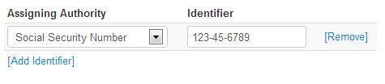
Notice Standard Fields
Type of number
The number
Dropdown List
(Can also just type into box. Sometime must be exact match. Others can be Free Text)
Adds
another
line
Removes
the
line

Slide 68
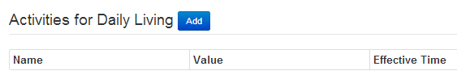
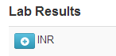
Other ways to Add another line
All data entered inline
Pops a data-entry
window
Pops data-entry line to the side

Slide 69
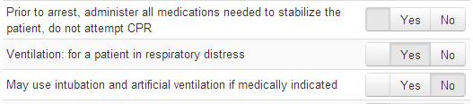
“Radio” Buttons – only 1 answer
Single answer buttons
No response
Yes
No

Slide 70

“Multiple Answer” Check Boxes
Yes
No response

Slide 71
Sections of Summary Document
Demographics
Advance Directives
Chief Complaint
History of Present Illness
Encounters
Problems
History of Past Illness
Family History
Social History/Risks
Allergies
Medications
Immunizations
Medical Equipment
Vital Signs
Physical Exam
Functional Status
Procedures
Results
Assessment
Discharge Diagnoses
Care Plan
Payers

Slide 72

Demographics

Slide 73


Demographics

Slide 74

Advance Directives

Slide 75

Advance Directives

Slide 76

Advance Directives

Slide 77

Chief Complaint/Reason for Visit

Slide 78
History of Present Illness

Slide 79

Encounters

Slide 80

Problems and Health Concerns

Slide 81

Problems and Health Concerns

Slide 82

History of Past Illness

Slide 83
Family History

Slide 84

Social History and Risks

Slide 85


Social History and Risks

Slide 86


Social History and Risks

Slide 87

Allergies and Adverse Events

Slide 88

Medications

Slide 89


Medications

Slide 90

Immunizations

Slide 91

Medical Equipment and Supplies

Slide 92

Vital Signs

Slide 93
Physical Exam, including Wounds

Slide 94


Functional Status

Slide 95


Functional Status

Slide 96



Functional Status

Slide 97



Functional Status

Slide 98

Procedures

Slide 99


Procedures

Slide 100

Results

Slide 101
Assessment = “Impression”

Slide 102

Discharge Diagnoses

Slide 103

Care Plan

Slide 104


Care Plan

Slide 105

Care Plan

Slide 106

Payers

Slide 107
Exit SEE – Click “X”

Slide 108
Find Edited Document and Send It

Slide 109
Find Edited Document and Send It
Login to organization’s Webmail mailbox
Open the blank “Use To Create New Documents – DO NOT DELETE!” mail
Download the attached document to SEE
Find the draft document in SEE
Edit draft document (warning for collision)
Review and Finalize document
Exit SEE, returning back to Webmail
Find message with document in Draft folder
Find destination recipient’s address
Send message

Slide 110
Login to Webmail

Slide 111
Open DO NOT DELETE Mail

Slide 112
Download Attached Document

Slide 113
Download Attached Document

Slide 114
Search by Patient Name

Slide 115

Select Sections to Update

Slide 116

Save Before Clicking on Review

Slide 117
Review Document
Hint: If Review button doesn’t work, close tab and open again. If still doesn’t work, close window and login again

Slide 118

Warning if Someone Else Editing

Slide 119

Finalize (Sign) Document

Slide 120

Finalize (Sign) Document

Slide 121
Send Document to Webmail

Slide 122

Send Document to Webmail

Slide 123
If you get an error…

Slide 124

…log back in to Webmail…
Note: You might need to Right-Click on blank area and then click on Reload symbol to see Login screen
Hint: Alt-Tab lets you jump between your windows making it easier to got to Webmail and back to SEE

Slide 125
…and Send Document again

Slide 126
Document sent to Webmail!

Slide 127
Exit SEE – Returning to Webmail

Slide 128

Find message/document in Draft folder
3
1
2

Slide 129

Find Destination Recipient’s Address

Slide 130
Send Message
Notes:
No way to notify if receiver ever opened it, however
Will get message if it was not delivered.

Slide 131
Start New Document from Scratch

Slide 132
Start New Document from Scratch
Login to organization’s Webmail mailbox
Open the blank “Use To Create New Documents – DO NOT DELETE!” mail
If you accidentally deleted it, go into your trash and forward it back to yourself
Download the attached document to SEE
Complete required fields at a minimum
Save new document as a draft or Review and Finalize
Exit SEE, returning back to Webmail

Slide 133
Login to Webmail

Slide 134
Accidentally Delete DO NOT DELETE Mail

Slide 135

Find DO NOT DELETE Mail in Trash

Slide 136
Forward DO NOT DELETE Mail to Self

Slide 137
Copy “From” into “To” Address

Slide 138
Open DO NOT DELETE Mail

Slide 139
Download Attached Document

Slide 140
Click on “New Document”

Slide 141

Enter Patient Information in Sections

Slide 142
Save as Draft or Finalize Document

Slide 143
Exit SEE – Click “X”

Slide 144
Find and Edit Hospital Note & MDS

Slide 145
Find and Edit Hospital Note & MDS
Login to organization’s Webmail mailbox
Open the blank “Use To Create New Documents – DO NOT DELETE!” mail
Download the attached document to SEE
Find the Hospital Summary in SEE
Copy all or part of old document into new document
Find the MDS in SEE
Copy part of MDS into new document
Edit new document
Save document as a draft or Review & Finalize
Exit SEE, returning back to Webmail

Slide 146
Login to Webmail

Slide 147
Open DO NOT DELETE Mail

Slide 148
Download Attached Document

Slide 149
Download Attached Document

Slide 150
Search by Patient Name

Slide 151
Copy All Into New Document

Slide 152
Copy All - Success!

Slide 153

Search by Patient Name for MDS

Slide 154

Go Back to Draft Document

Slide 155

Pick Section and “Copy From”

Slide 156

“Copy From” – Success!

Slide 157
Review and Update Each Section

Slide 158
Save as Draft or Finalize Document

Slide 159
Exit SEE – Click “X”

Slide 160
Workflow
Walkthroughs

Slide 161





LTPAC Communication using SEE
CCD+ = Transfer Summary
CCD+
CCD+
PCP
Home Health
CCD+
CCD+
SEE
CCD+
MDS
KeyHIE Transform
Hospital
Billing Program
MDS
Nursing Facility

Slide 162
LTPAC Communication using SEE
Overlook
VNA CN
Reliant
FHCW
SVH
UMass
Beaumont
Christopher House
Fairlawn
Holy Trinity
Jewish
LCCA
Millbury
Notre Dame
Worcester Rehab
FCHP

Slide 163
SEE Fixes/Enhancements Coming

Slide 164




Questions?
Lawrence.Garber@ReliantMedicalGroup.org

